Slide 1





Grimm’s Academy
32nd Life
The Oracle

Slide 2
Questions
What type of attack is occurring in this pcap?
What was the bypass to the first login?
What was the database name?
What was the Full version of the database to the version number?
What user is the database running as?
What is the hash of the admin password?
What is the name of the file that was uploaded to the server?
What was the flag the was echoed on the server?

Slide 3
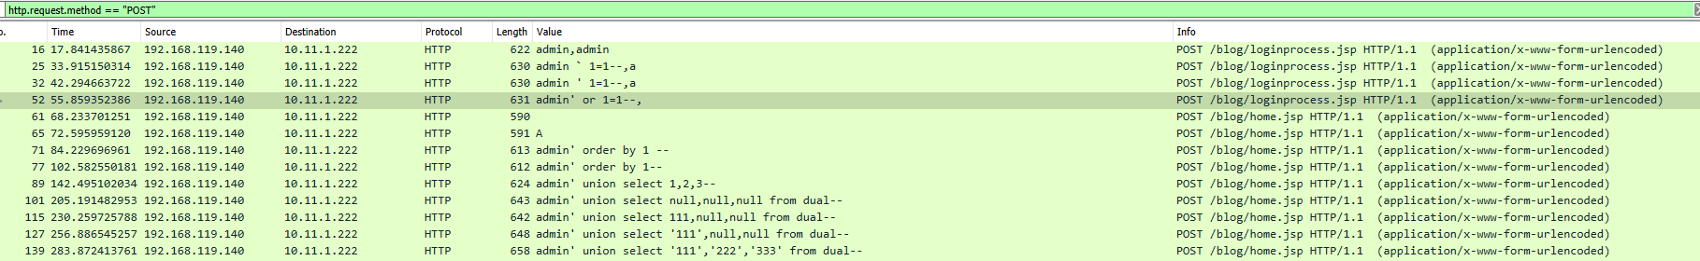
Question 1
What type of attack is occurring in this pcap?
Check out all the html POST that is going on in this pcap.
Does anything stand out?

Slide 4
What is Sql Injection?
Web security vulnerability that allows an attacker to interfere with the queries that an application makes to its database.
Allows an attacker to view data that they are not normally able to retrieve.
Types of SQLi Attacks:
Error Based
Union Based
Blind Boolean
Blind Time

Slide 5
Error based Injection:
The attacker sends some malicious query to the database which results in errors.
The errors should be very generic, otherwise, they may give useful hints to the attacker.
Comment-Line: Using comment line to cause the database to ignore a part of a valid query.
E.g. Select * from stores where product_id = blah’ or 1=1-- (everything after this will be neglected)
Tautology: There are a lot of strings which always evaluates to be true, like ‘1’ = ‘1’ ‘a’ = ‘a’, etc., using them in the query to create constantly true conditions.
E.g. Select * from users where username=’blah’ or ‘a’=’a’ -- and password=’pass’

Slide 6
Union Based SQL injection:
Using union command in SQL query to execute additional queries; thereby, modifying/inserting/deleting or dropping the contents of the table.
E.g. Select * from stores where product_id=1 union select 1,database(),user(),4#
Stored procedures: Creating malicious inputs to execute malicious queries.
Incorrect queries: Coming up with logically incorrect queries to see the error messages to get more information about the target database.
Select * from stores where id=1’
The above query will result in a syntax error and might reveal the backend database type.

Slide 7
Blind SQL injection - Boolean:
Boolean: Only correct queries show the result, wrong queries do not return anything. Attackers should try to generate logically correct queries.
If suppose the original query to the database is
Select * from users where id=’id.txt’
If we give blah’ and 1=1# as input which evaluates to be a right query
Select * from users where id=’blah’ or 1=1#, we will see the user results.
If we give blah’ and 1=2# as input which is a wrong query then we don’t see any results.
Select * from users where id=’blah’ or 1=2#

Slide 8
Blind SQL injection – Time Based:
Depending on some conditions, setting a time delay.
If that condition is satisfied, we can observe the time delay;
Thereby, concluding that the input we gave produced a positive result.

Slide 9
Question 2
What was the bypass to the first login?
Look at the POST to the loginprocess.jsp page

Slide 10
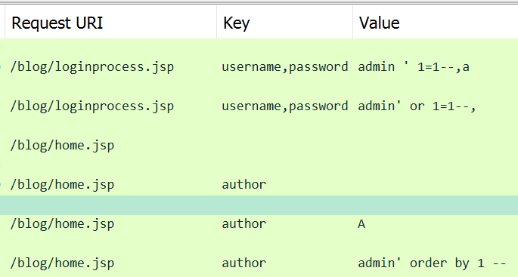
What Happens Now?
So now that the attacker has a way into the first login page they have a second form that is also SQL injectable on the Author Form.

Slide 11
What is the Attacker Doing Next?
Now that they were logged into the webpage, the attacker was now trying to get a foothold on the system some how.
With the new sql injectable web page, the attacker is starting to enumerate the system to see if there is a way to compromise it from the web page.
On this webpage there is a second admin password, but it was not vulnerable to injections.
The attacker must try and utilize the Author database somehow in order to get into the admin section

Slide 12
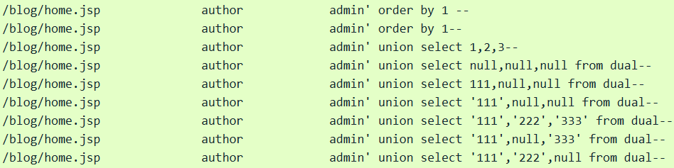
Utilizing a Union SQLi
In the below screenshot we can see that the attacker is locating fields on the web page that return information.
When looking at the traffic you will see that 111 and 222 are used to display the injected commands on the SQL database.

Slide 13
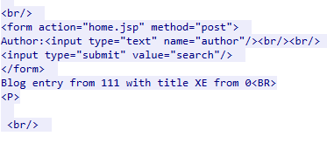
Question 3
What was the database name?
If we look at the various sql injections, is there a command that might tell us the name of a Database?
admin%27+union+select+%27111%27%2Cora.database_name%2Cnull+from+dual—
Command injected: ora.database_name

Slide 14
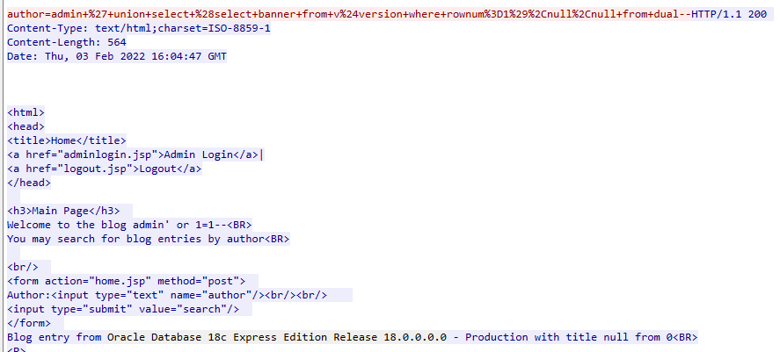
Question 4
What was the Full version of the database to the version number?
admin+%27+union+select+%28select+banner+from+v%24version+where+rownum%3D1%29%2Cnull%2Cnull+from+dual—
Injected command: select banner from v$version where rownum=1

Slide 15
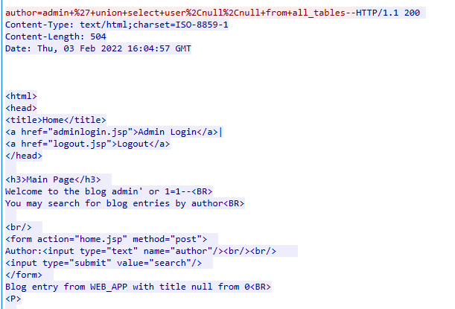
Question 5
What user is the database running as?
admin+%27+union+select+user%2Cnull%2Cnull+from+all_tables--

Slide 16
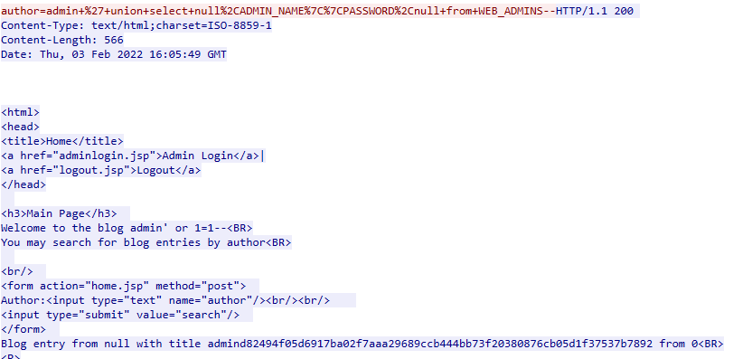
Question 6
What is the hash of the admin password?
admin+%27+union+select+table_name%2Cnull%2Cnull+from+all_tables--

Slide 17
Admin Account Compromised
Once the hash of the admin account is grabbed, the attacker cracked the hash and found that the cracked password allowed them to log into the admin panel on the page.
In the admin panel there was a section that allowed for file uploads to the server.
The attacker uploaded a reverse shell that allowed them to remotely compromise the system.
Notice the server was running java and what is the file type of the shell?

Slide 18
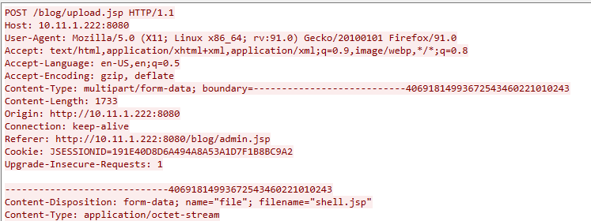
Question 7
What is the name of the file that was uploaded to the server?

Slide 19
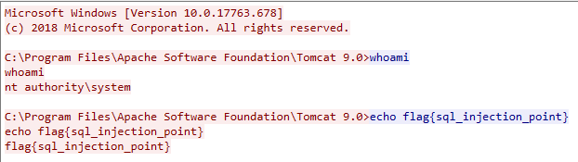
Question 8
What was the flag the was echoed on the server?

Slide 20
Recap
Powershell-Empire encrypts the traffic by default, so being able to spot the beaconing traffic may be best clue to finding traces of it existing from the Network.
An adversary can gain a foothold from a single hole on a web page.
User-Agents are a great way to get an idea of what could be going on in the traffic, if they have not been adjusted.

